Slide 1
System Book Library
Dr.Mohamed Assal.
Eng. Abdelrahman Saad .
Salma EL-Sayed 17105510.

Slide 2
This system is a software that helps any bookstore maintain the best service for all customers. It is built in a way that is fully functional and easy to use. This system will help us track all customer details in order to provide the best service. All history of all purchases are saved in the system helping the process of gathering knowledge about all customers in order to reach pure customer seller satisfaction.

Slide 3
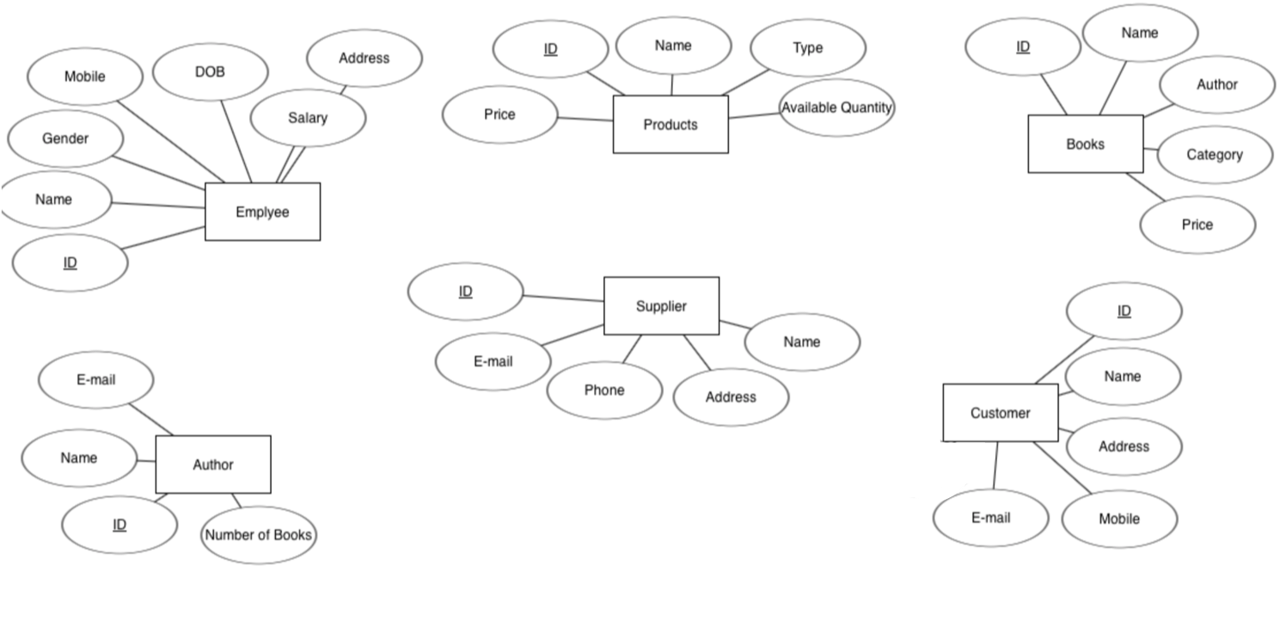
1-Employee Sells Products | 2-Employee Sells Books | 3-Customer Buys Products
4-Customer Buys Books | 5-Author Writes Books | 6-Supplier Supplies Products

Slide 4
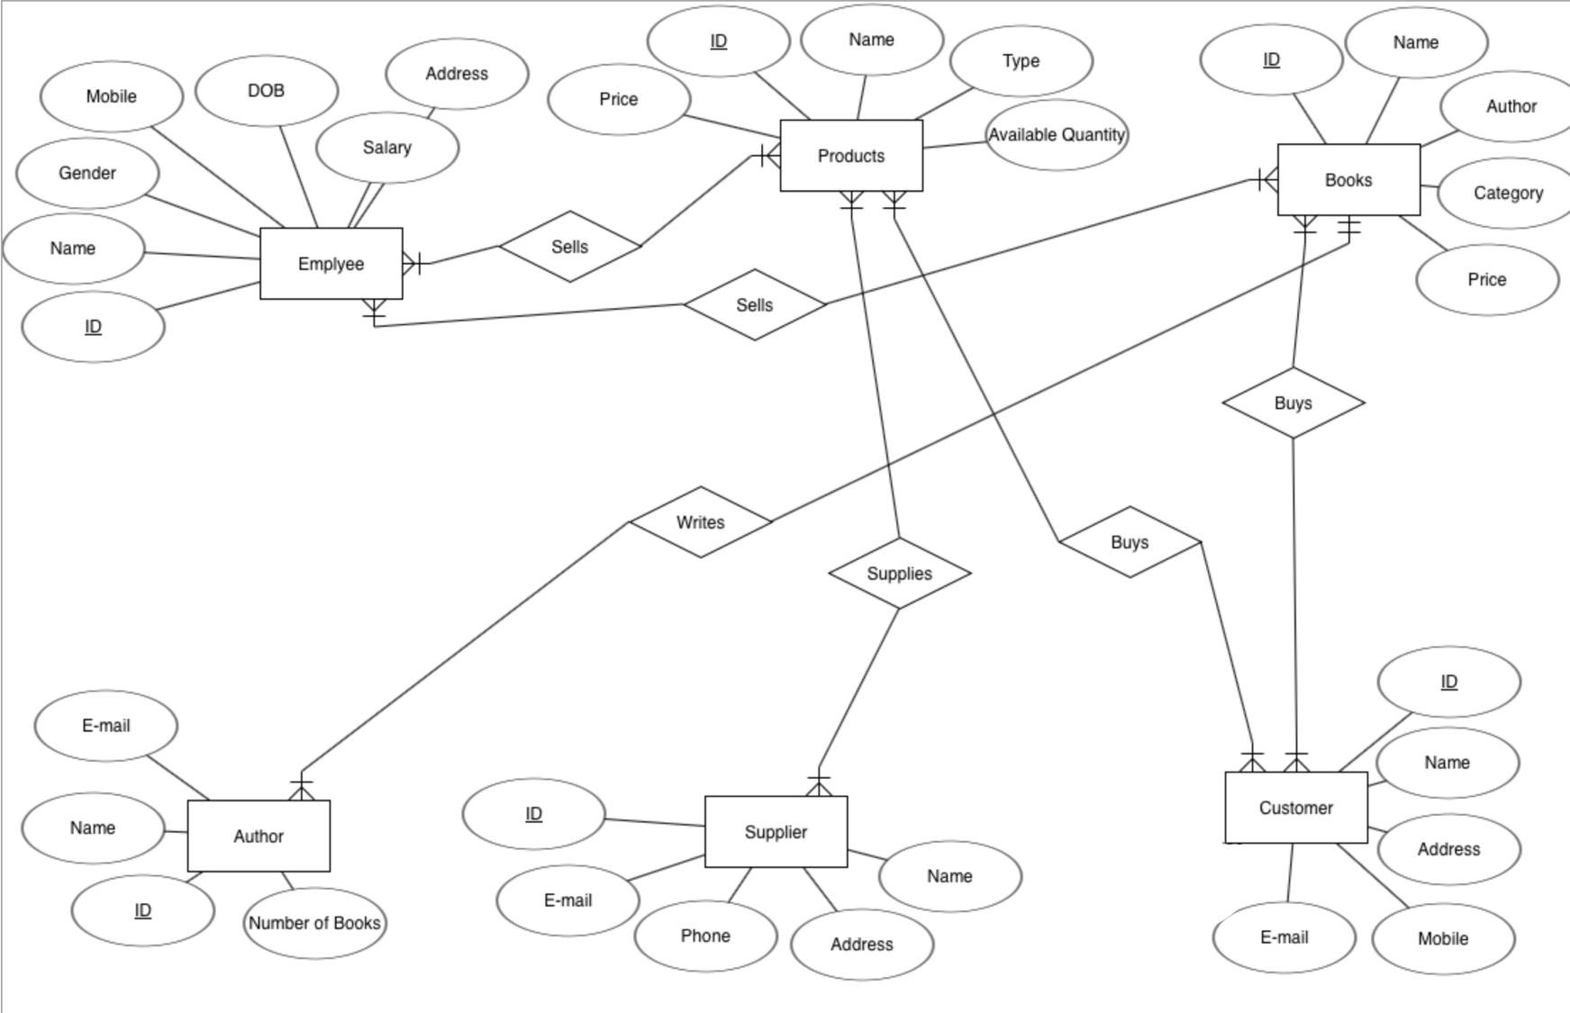

Slide 5
Employee
ID | Name | Gender | DOB | Salary | Mobile | Address
Employee_Products
E_ID | P_ID
Product
ID | Name | Price | Type | Available_Quantity
Employee_Books
E_ID | B_ID
Books
ID | Name | Author | Price | Category
Customer_Product
C_ID | P_ID
Customer
ID | Name | Address | Mobile | E-mail
Customer_Books
C_ID | B_ID
Supplier
ID | Name | Address | E-mail | Phone
Supplier_Product
S_ID | P_ID
Author
ID | Name | Number_of_Books | E-mail

Slide 6
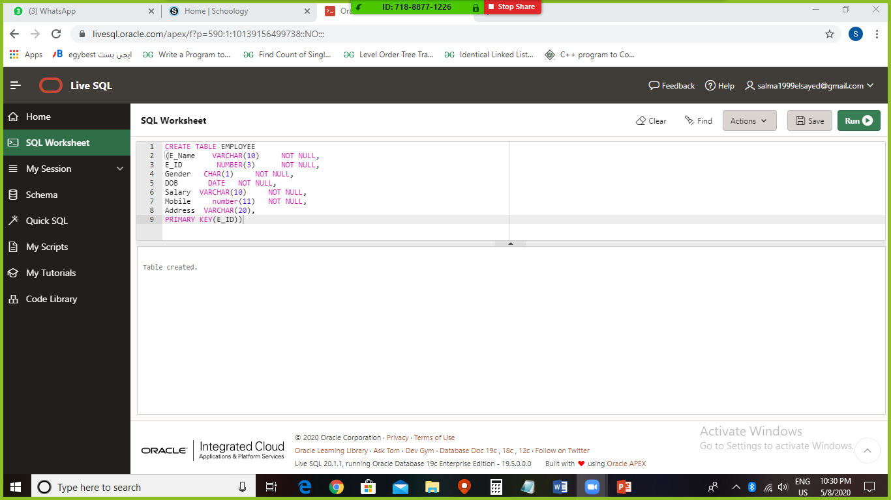
.Create Tables(EMPLOYEE):

Slide 7
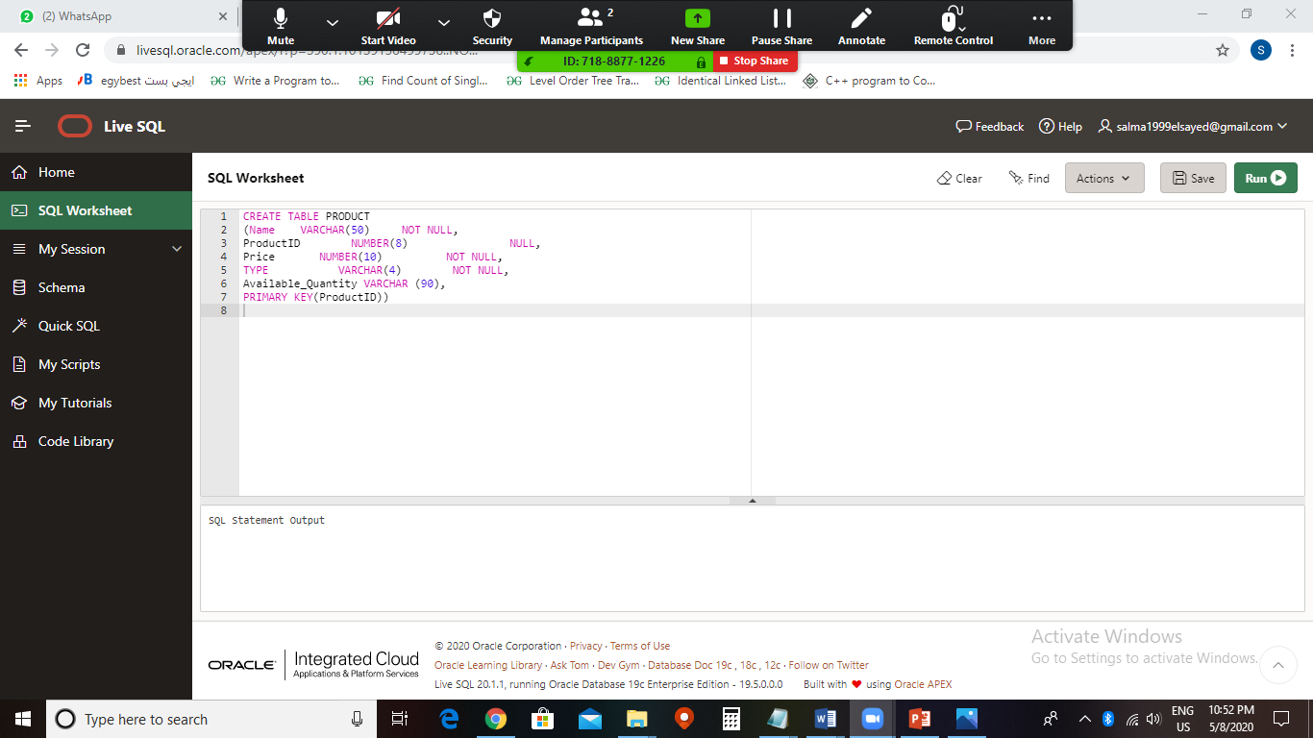
.Create Tables(PRODUCT):

Slide 8
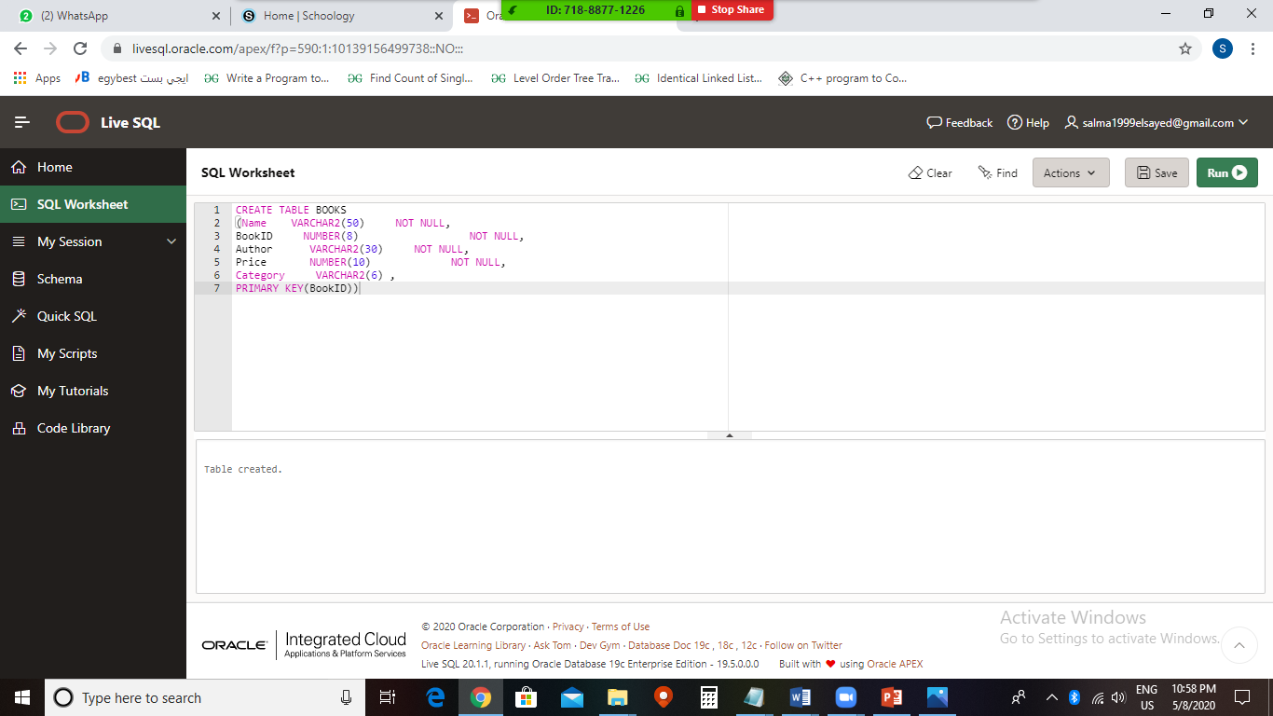
.Create Tables(BOOKS ):

Slide 9
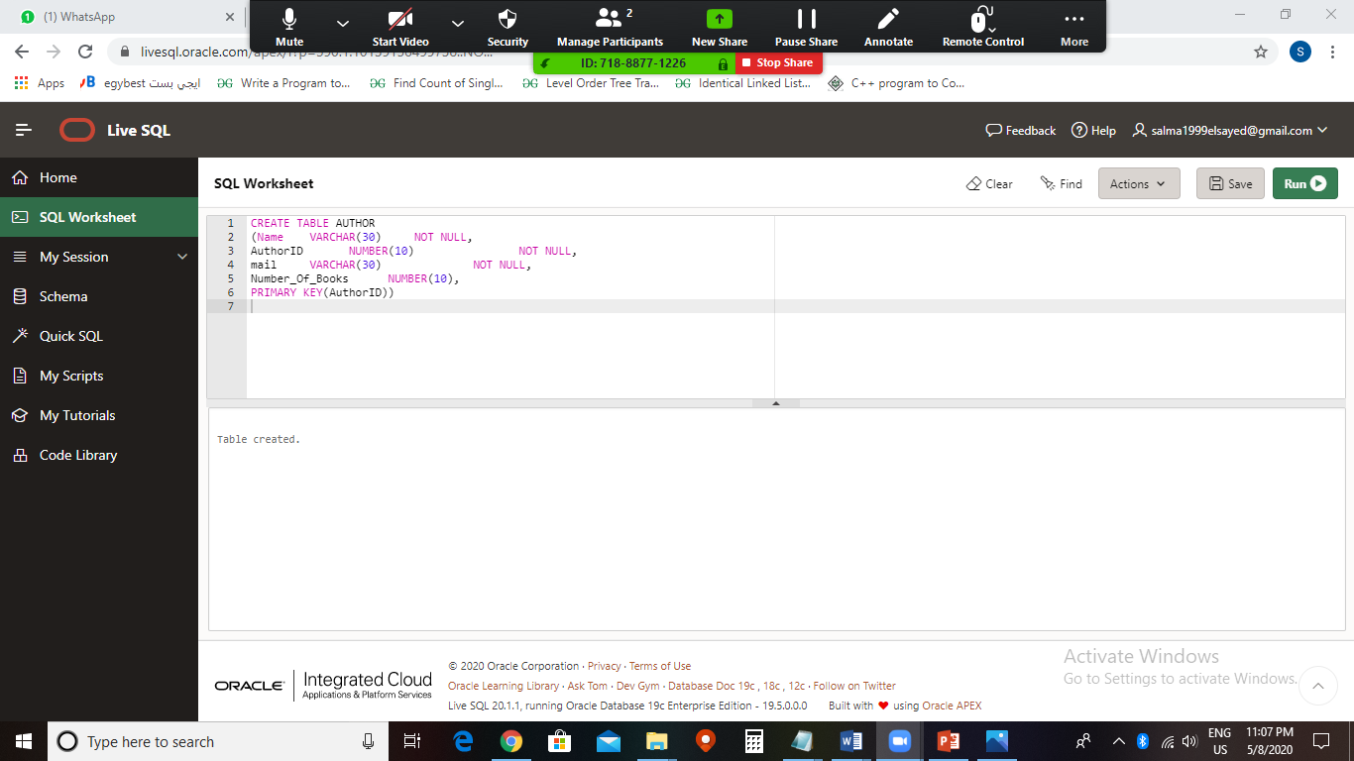
.Create Tables(AUTHOR):

Slide 10
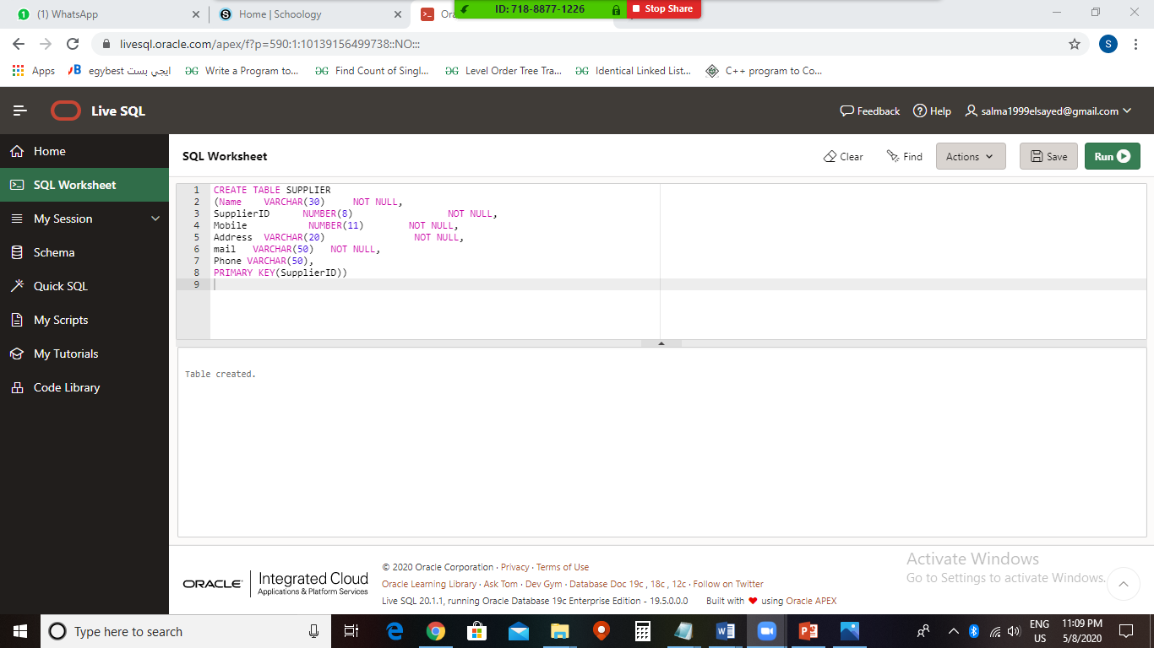
.Create Tables(SUPPLIER):

Slide 11
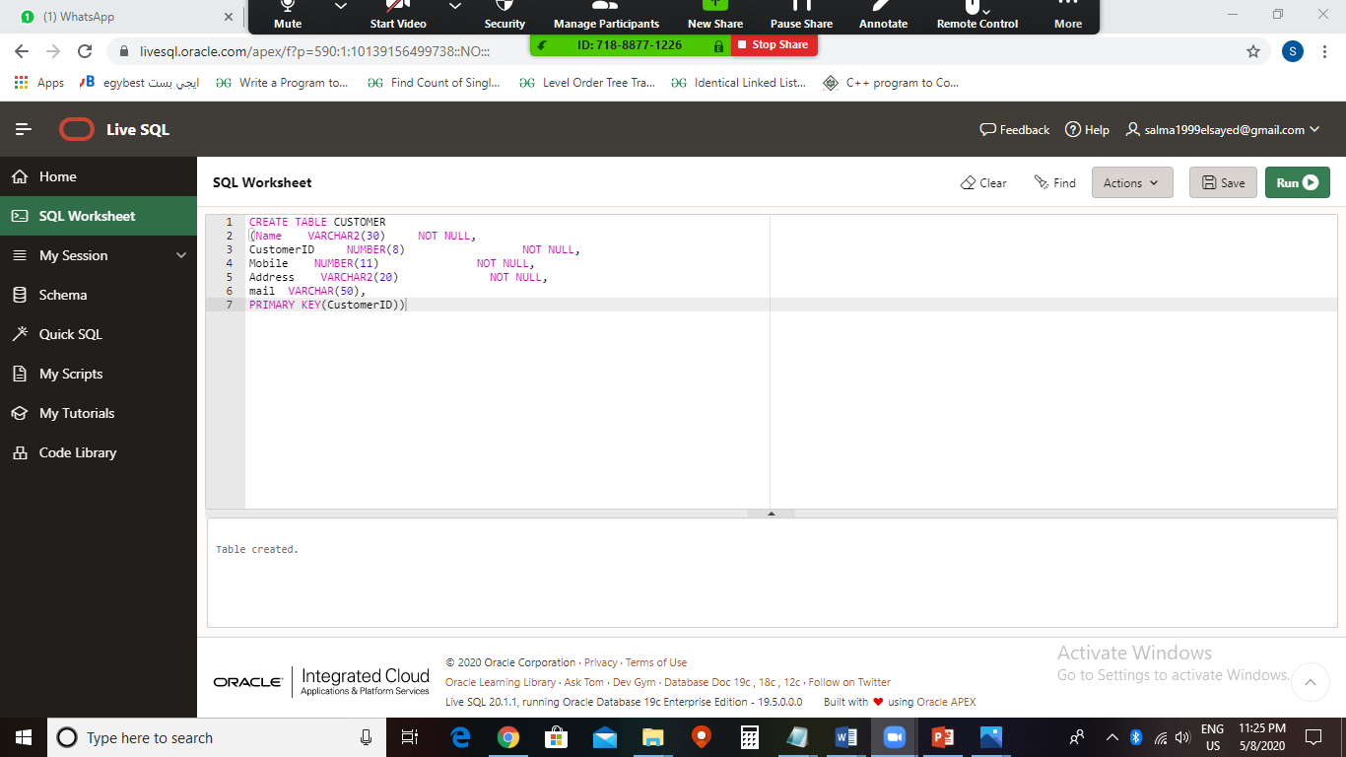
.Create Tables(CUSTOMER):

Slide 12
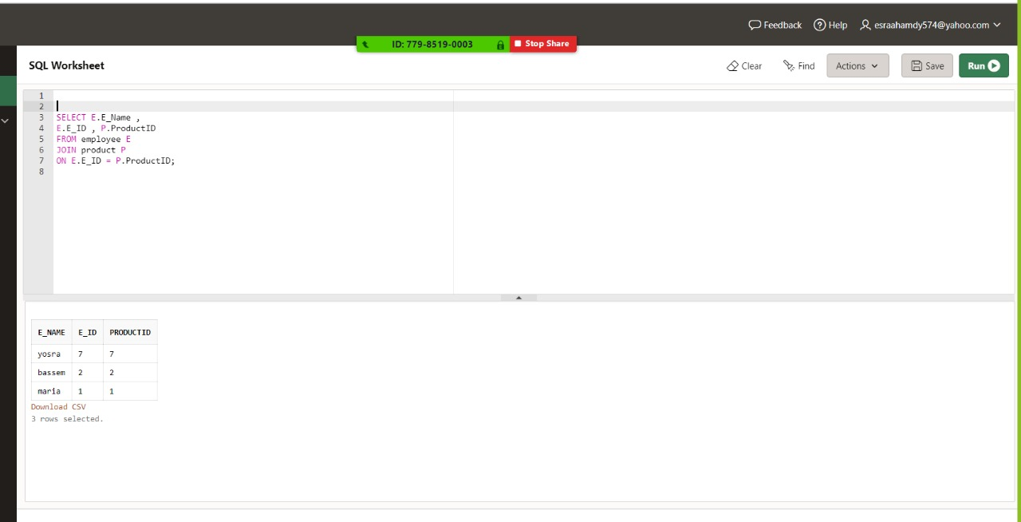
.Complicated Quire:

Slide 13
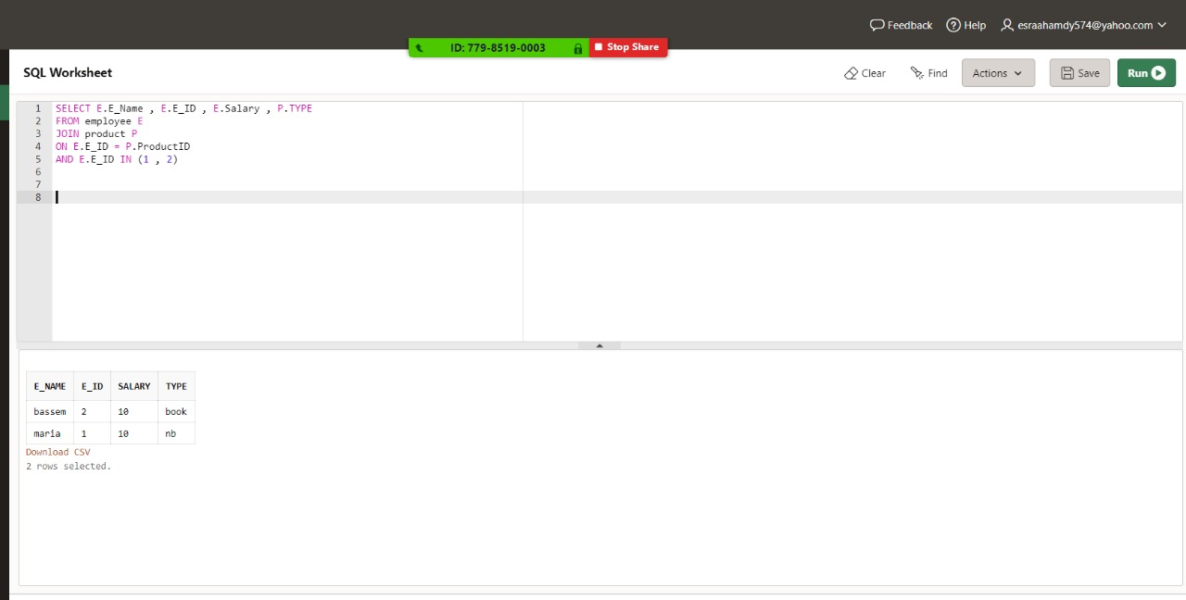
.Complicated Quire:

Slide 14
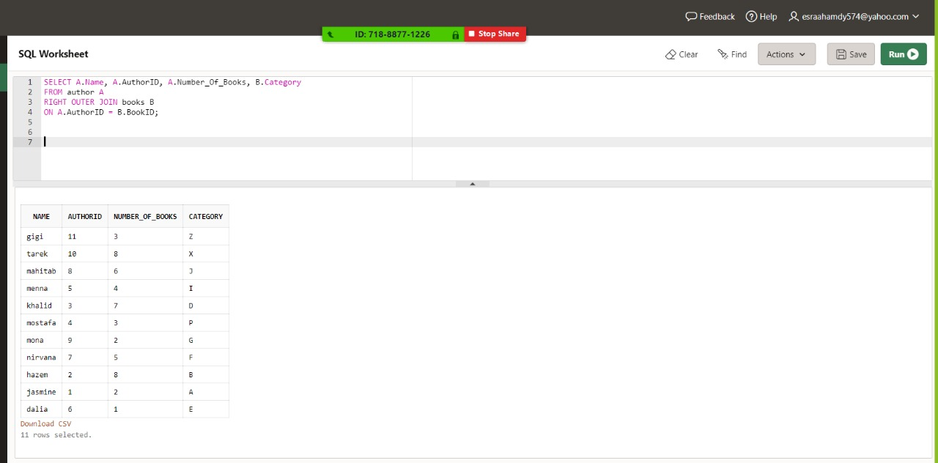
.Complicated Quire:

Slide 15
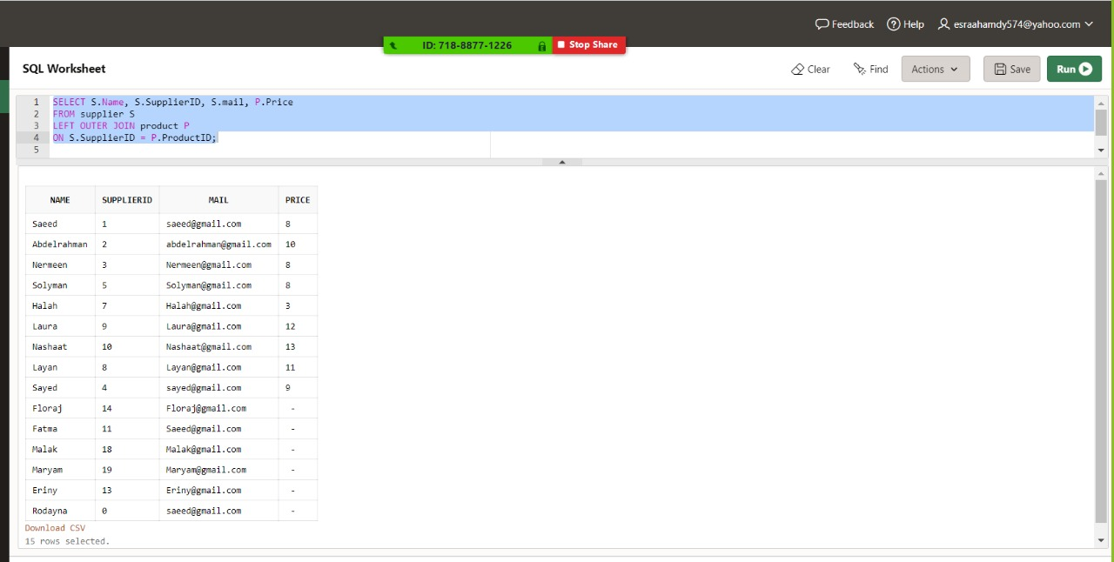
.Complicated Quire:

Slide 16
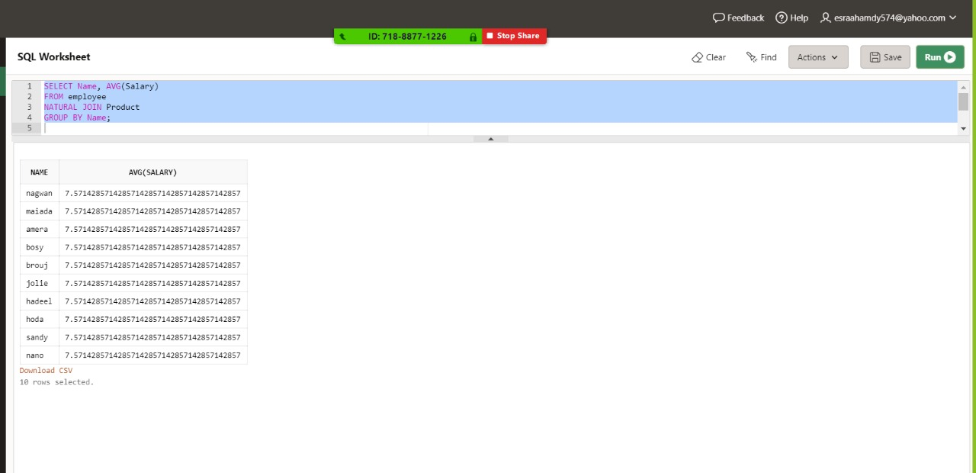
.Complicated Quire:

Slide 17
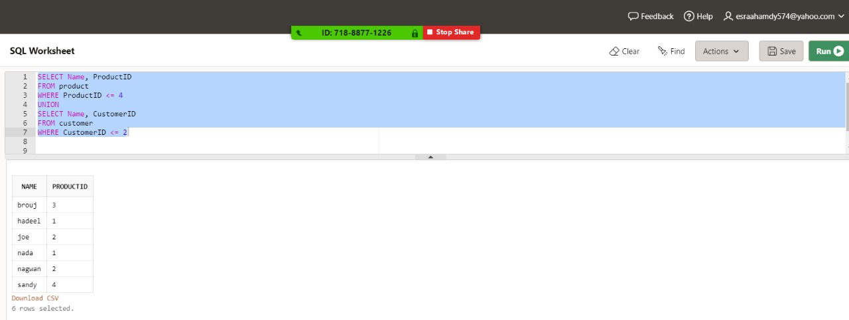
.Complicated Quire:

Slide 18
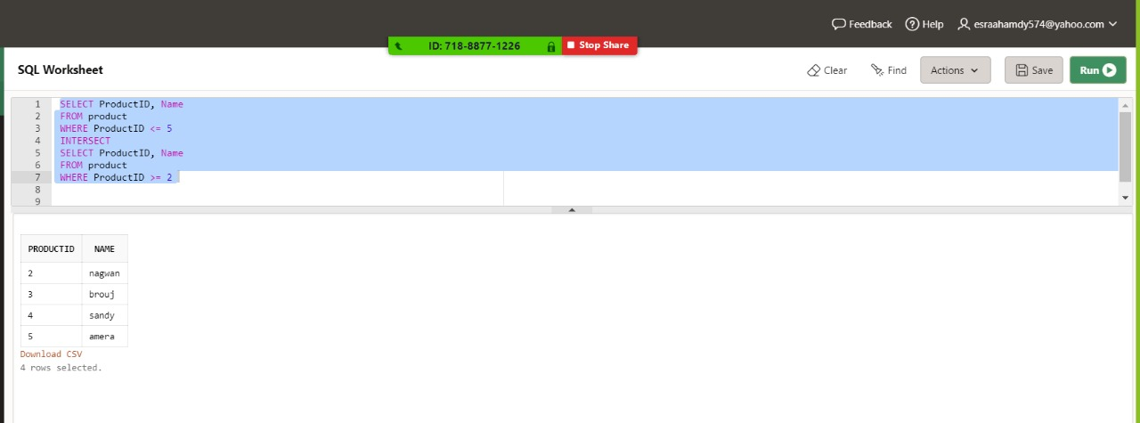
.Complicated Quire:

Slide 19
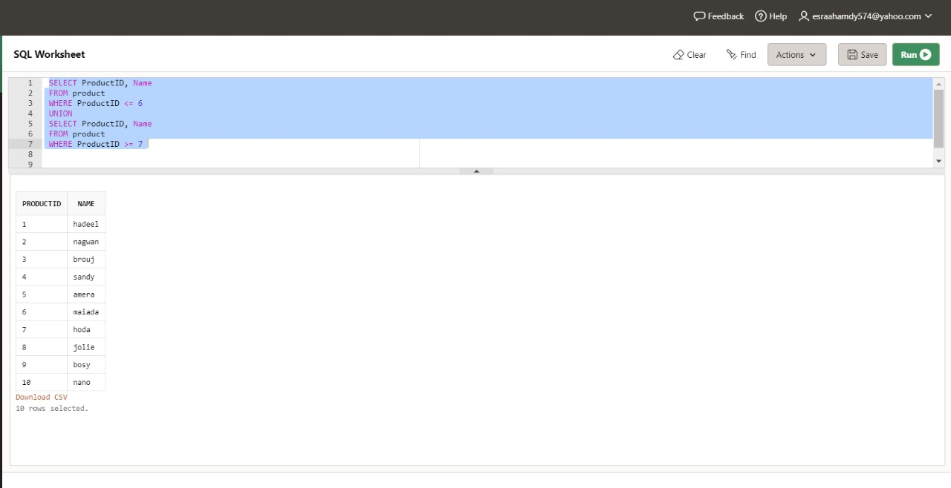
.Complicated Quire:

Slide 20
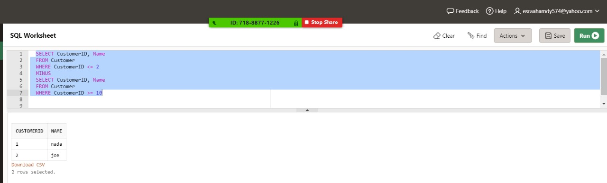
.Complicated Quire:

Slide 21
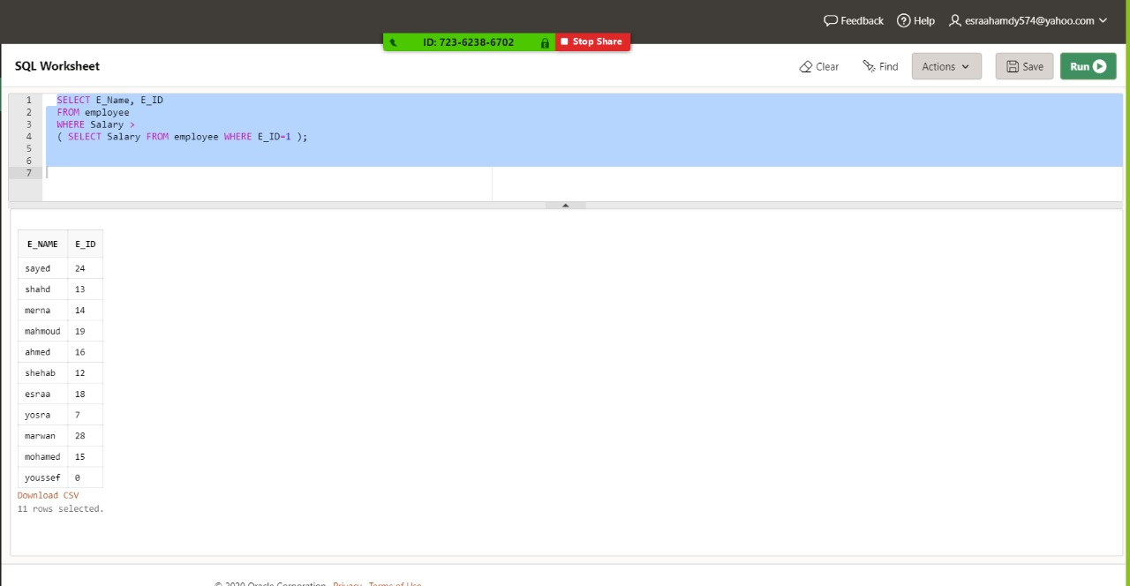
.Simple QUIRE:

Slide 22
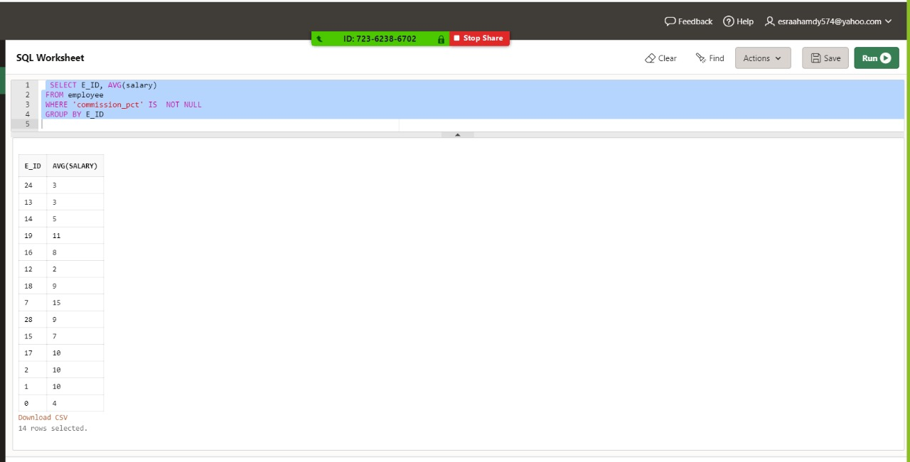
.Simple QUIRE:

Slide 23
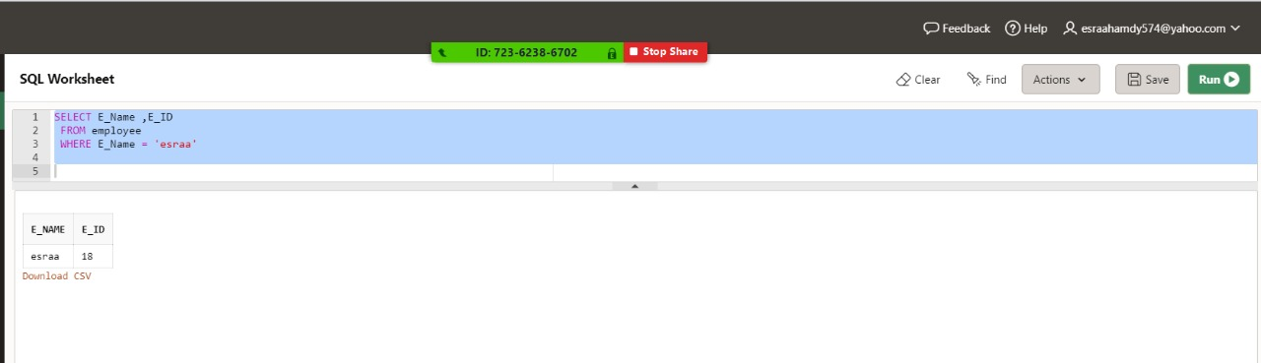
.Simple QUIRE:

